Slide 1
Anatomical variations associated with pregnancy
Dr. Sanskruti Tahakik
Dept. Of Community Physiotherapy
Mgm Institute Of Physiotherapy
Chh. Sambhajinagar

Slide 2
Contents
changes in
Genital organs
Uterus
Endometrium
Breast
Cardio-vascular system
Respiratory system
Urinary system
Uterus

Slide 3
Postural changes in pregnancy
Physiotherapy management

Slide 4
Introduction
During pregnancy there is progressive anatomical ,physiological and biochemical change to all systems of body
Changes are due to metabolic demands of fetus and hormonal influence

Slide 5
Genital organs
Vulva: vulva becomes oedematous and more vascular
Superficial varicosities may appear
Libia minora are pigmented and hypertrophied
vagina: vaginal walls become hypertrophied oedematous and more vascular

Slide 6
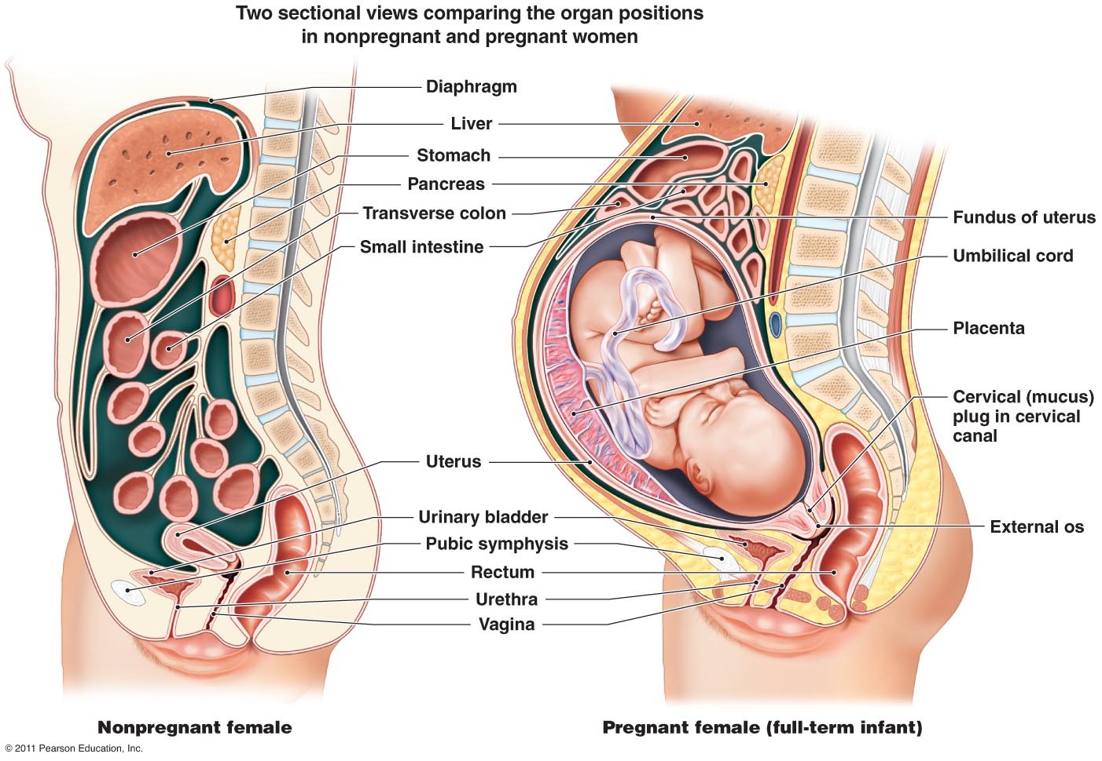

Slide 7
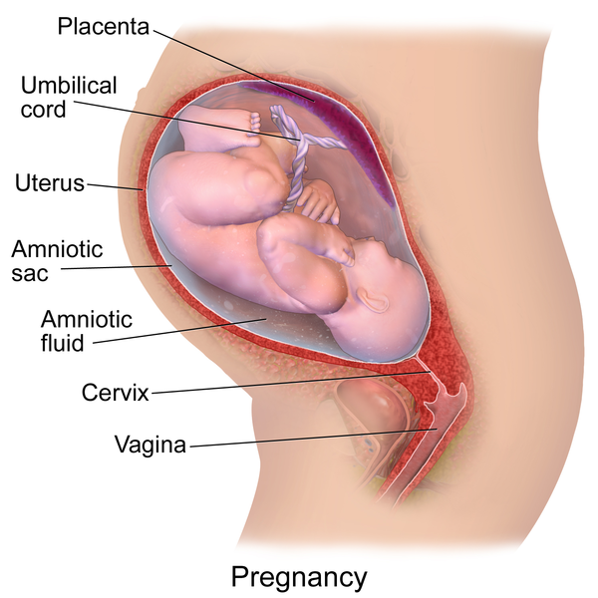

Slide 8
Increased blood supply of the venous plexus surrounding the walls gives bluish coloration of mucosa (jacquemier`s sing )
Length of anterior wall of vagina is increased
Secretions become copious thin and curdy white due to exfoliated cells and bacteria.

Slide 9
Changes in uterus
Non pregnant
Weight 60 gm
Length 7.5cm
AT term
Weight 900-1000gm
Length 35cm
Capacity is increased by 500-1000 times

Slide 10
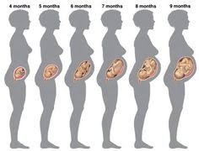

Slide 11
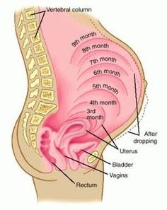

Slide 12
Changes occur in all the parts of the uterus
Body , Isthmus and cervix
Body of uterus : enlargement - hypertrophy and hyperplasia
Stretching: distension by growing featus
In non pregnant blood supply is by uterine and least through ovarian
In pregnant state marked spiralling of arteries uterine artery diameter doubles

Slide 13
Veins become dilated and valve less
The fundus enlarges more than the body .
Shape : non-pregnant: - pyriform shape is maintained in early months
Becomes globular at 12 weeks as uterus enlarges becomes ovoid by 28 wks and changes to spherical beyond 30th week

Slide 14
Position : normal anteverted position is exaggerated upto 8 weeks thus enlarged uterus may lie on bladder rendering it incapable of filling ,clinically evident my frequency of micturition.
It becomes erect long axis of uterus conforms more or less to the axis of the inlet. As term approaches, there is tendency of anteversion

Slide 15
Lateral obliquity
As the uterus enlarges to occupy abdominal cavity
Rotates on its long axis to right(dextrorotation)
The cervix: deviated to left side (levorotation) bringing it close to ureter.
Uterine peritoneum: The uterosacral ligament and bases of broad ligament rise up to the level of pelvic rim.
Deepening of the pouch of douglas

Slide 16
Contractions(Braxton-hicks)
Uterus undergoes spontaneous contractions irregular infrequent spasmodic and painless without any effect of dilatation of cervix.
Endometrium :- increased structural and secretory activity of the endometrium
Isthmus: isthmus hypertrophies and elongates about three times of its original size

Slide 17
Fallopian tube:-
Uterine end rises up fimbriae end held up by infundibulopelvic ligament
placed almost vertical by side of uterus.
At term :- because of marked growth of fundus, the tube becomes congested.

Slide 18
Breasts:-
Size: increased size of breasts evident in early weeks
Nipples and aerola- nipples become larger erectile and deeply pigmented.
Sebaceous glands hypertrophied called montogomery,s tubercles.
Secretions- colostrum can be squeezed out of the breast about 12th week

Slide 19
Cutaneous changes:
Abdomen: linea nigra – brownish black pigmented area stretching from the xiphisternum to symphysis pubis.
Striae gravidarum depressed linear marks the stretch marks represent the scar tissue in the deeper layer of cutis.

Slide 20
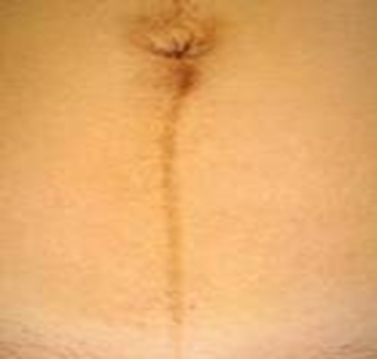
Linea nigra

Slide 21
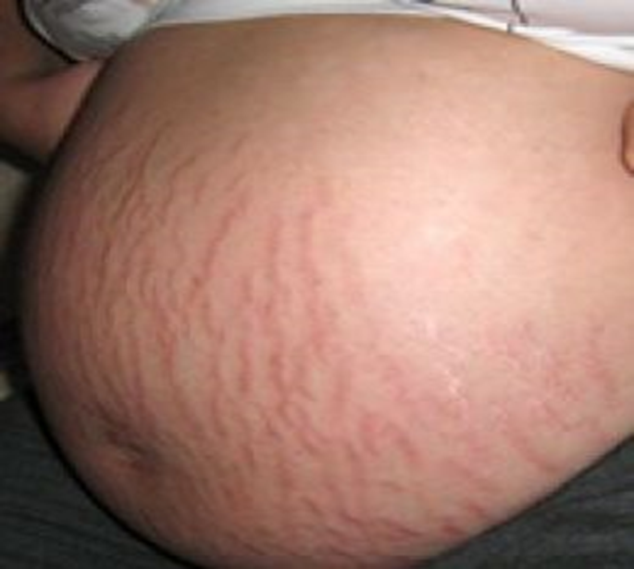
Stria gravidarum

Slide 22
Cardio vascular
Elevation of diaphragm consequent
to the enlarged uterus
Heart pushed upwards And outward
Apex beat shifted to 4th intercostal space about 2.5cm outside the midclavicular line.

Slide 23
Elevation of diaphragm by 4cm
Total lung capacity reduced by 5%
Diaphragmatic excursion increased by 1-2cm and breathing becomes diaphragmatic
The transverse diameter of the chest expands by 2cm
Chest circumference increases by 5-7 cm.

Slide 24
Urinary system
Kidney – dilatation of ureter Renal pelvis and calyces.
Kidney enlarge in length by 1cm
Renal plasma flow increased by 50-75% by 16 weeks
Ureter becomes atonic
Dilatation of ureter above pelvic brim with stasis marked between 20-24 weeks.

Slide 25
Bladder : hyper-trophy of the muscles and elastic tissue of the wall
In late pregnancy bladder mucosa becomes oedematous due to venous and lymphatic obstruction.

Slide 26
Alimentary system
Muscle tone and motility of gastrointestinal tract are diminished due to high progesterone level.
Cardiac sphincter is relaxed and regurgitation of acid gastric content into the oesophagus may produce chemical esophagitis and heart burn.
There is diminished gastric secretion and delayed emptying time of the stomach.
Atonicity of the gut leads to constipation .

Slide 27
Nervous system
Compression of the median nerve
Carpal tunnel syndrome

Slide 28
Postural changes
Tendency of increased anterior displacement of LOG
Active posterior displacement of body
Increased of lumbosacral angle.
Increased of curvature
Displacement of pelvis anterior
Displacement of shoulder posteriorly
Increased thoracic Kyphosis

Slide 29
Abdominal muscles are stretched to the point of their elastic limit by the end of pregnancy.
Hormonal influence decrease in ligamentous tensile strength
And an increase in mobility of structures supported by ligaments and may predispose the patient to joint injury especially in the weight-bearing joints of the back, pelvis and lower extremities.

Slide 30
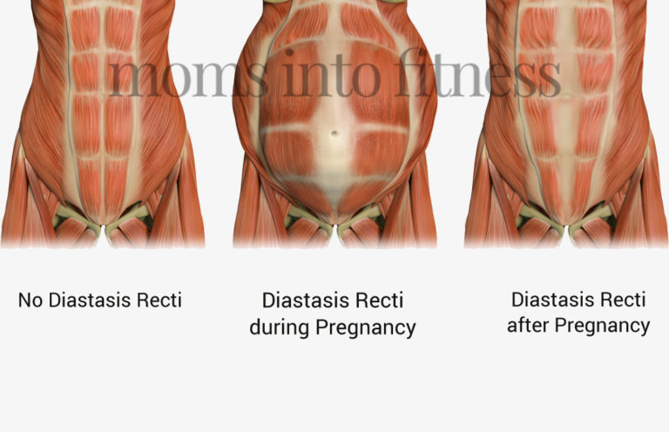

Slide 31
Increased lumbar lordosis
Anterior displacement of sacrum posterior displacement of trunk thus increased lumbar lordosis.
Spinal instability due to changes in ligamentous restrain and
Lengthening of abdominals
Pelvic ligament and pubic symphysis relax widen and more flexible
Increased mobility eases birth passage .

Slide 32
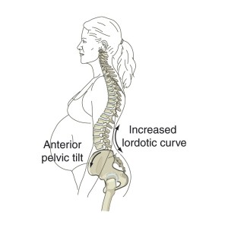

Slide 33
PT treatment :
Explain importance of posture during ADL`S
Postural education
Activation of transversus abdominis and multifidus to improve spinal stability

Slide 34
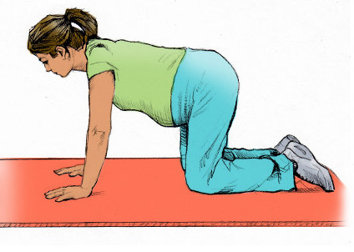

Slide 36
References
D.C Dutta`s Textbook of obstetrics seventh edition
Women`s health Textbook for physiotherapist R Sapsford

